Slide 1

Building a Better Cohort of Patients with Hypercapnic Respiratory Failure
Brian Locke, MD
T32 Fellow. Division of Pulmonary, Critical Care, and Occupational Pulmonary Medicine
Wayne Richards MS, Joseph Finkelstein MD PhD MA, Jeanette Brown MD PhD, Ramkiran Gouripeddi MBBS MS, Krishna M Sundar MD Departments of Internal Medicine and Biomedical Informatics
This research was supported by the National Institutes of Health under Ruth L. Kirschstein National Research Service Award 5T32HL105321 and the American Thoracic Society Academic Sleep and Pulmonary Integrated Research/Clinical Fellowship (ASPIRE) Program

Slide 2
Overview
10 slides on the problem
10 slides on what we’ve done
10 slides on what we plan to do

Slide 3
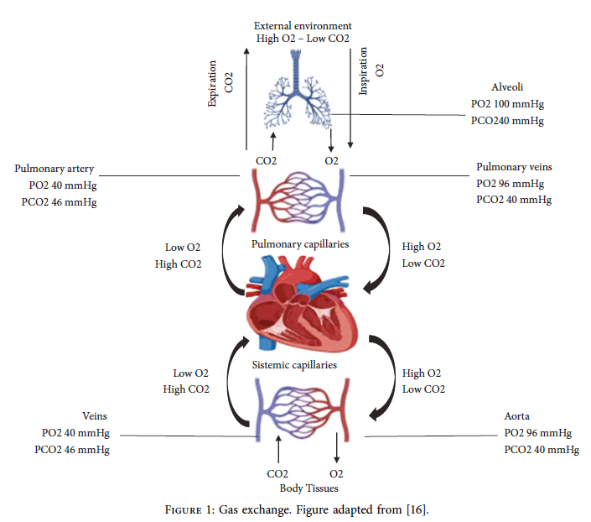
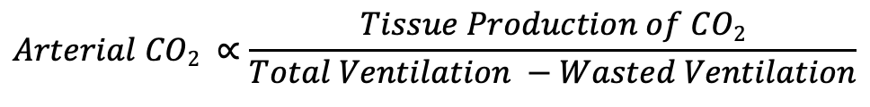
What is Hypercapnic Respiratory Failure?
$$Arterial CO2 ∝\frac{Tissue Production of CO2}{Total Ventilation −Wasted Ventilation}$$
Diseases that cause hypercapnia (↑ Arterial CO₂)
↑ Requirement | ↓ Capacity | ↓ Drive
COPD (inefficient ventilation) Obesity (more CO2 production) | Neuro-musc. disease COPD Obesity | Opiates Metabolic Alkalosis
Notes:
There are two purposes to the respiratory system: get enough oxygen to the blood, and get enough CO2 out of the blood.
TODO: [ ] back to the schema
[ ] Decrease to ONLY low ventilation = CO2 goes up, like in the valley with pollution.

Slide 4


Hypercapnia is common…
Common contributors to Hypercapnic Respiratory Failure:
Advanced Age
Opiate Use
Obesity
Advanced Lung Dz
Multimorbidity
Population-standardized prevalence PaCO2 > 45 mmHg after excluding iatrogenic causes:
150* per 100,000 person/year
Only inpatients, only those with blood gasses checked
Comparison: Decompensated Cirrhosis 94.9 (US, 2017) per 100,000 person-year
Notes:
[ ] todo: simplify to Just the causes, no comparison to Cirrhosis.

Slide 5
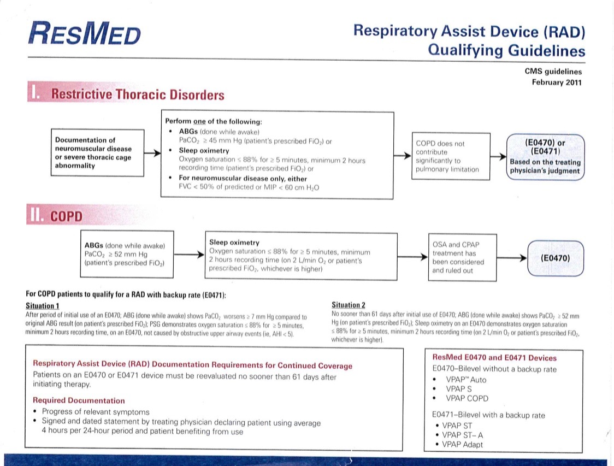
Age Group | Prevalence Per 100,000 p.yr.
15-24 | 14 (9-22)
25-34 | 29 (22-39)
35-44 | 42 (33-54)
45-54 | 80 (66-96)
55-64 | 196 (71-225)
65-74 | 517 (463-577)
75-84 | 1160 (1046-1286)
85+ | 1712 (1481-1980)

Slide 6
Hypercapnia is associated with high - and likely increasing - morbidity, mortality, and cost
Inpatient ICD code for Hypercapnic Respiratory Failure
23% 30d readmission rate
Same as CHF, more than MI
66% with recurrence
Decompensated Cirrhosis, for reference
Notes:
It’s common, and it’s a problem. - probably

Slide 7
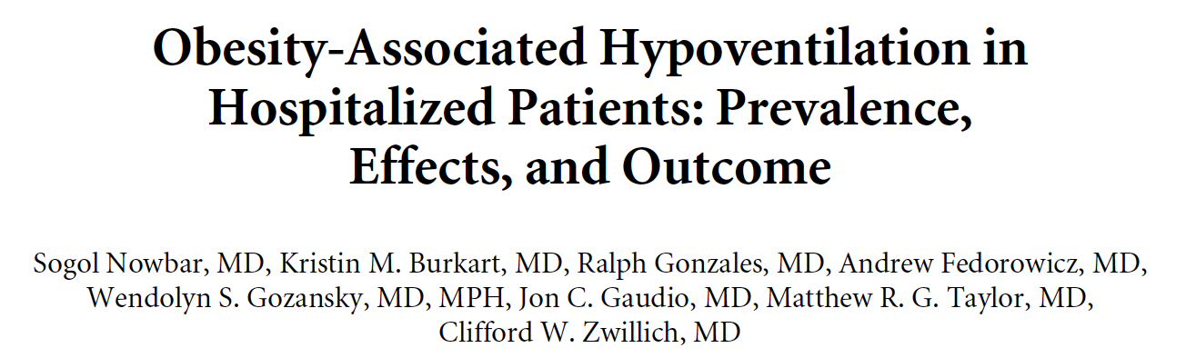
Patients with hypercapnia are identified unreliably and late in their illness
Published 2003; 3 hospitals, Denver
ABG on all inpatients BMI 35+
31% with unrecognized with hypercapnia
Notes:
involved obtaining an arterial blood gas on all adult patients with obesity (BMI > 35 kg/m²). After excluding ten patients with FEV1/FVC <50% or prior lung resection, 32 patients using opiates, and 85 that could not or did not consent, they found that 47 of 150 (31%) patients had hypercapnia with a pH lower than 7.42. 48% (14 of 29) with a BMI above 50 kg/m² had hypercapnia using an elevation-adjusted threshold (5200ft study elevation of the 3 study centers).

Slide 8
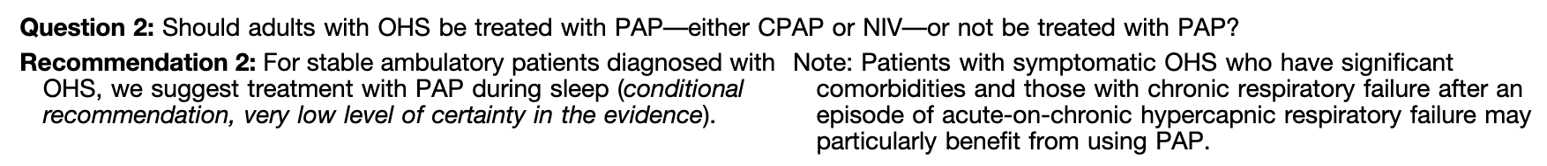

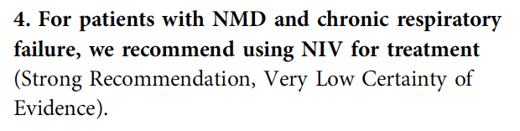
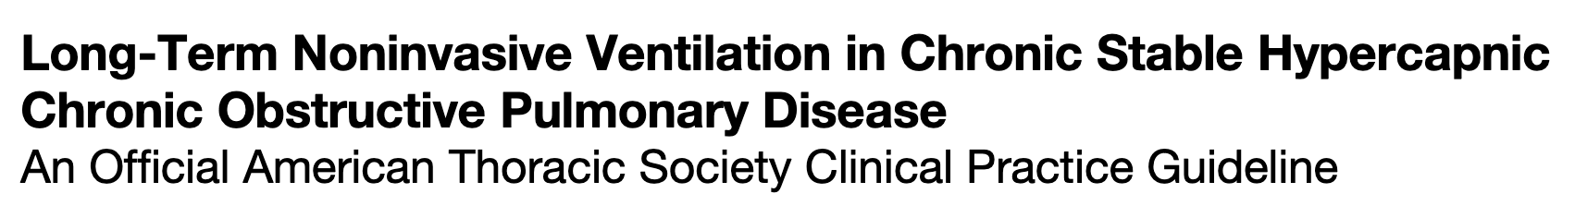
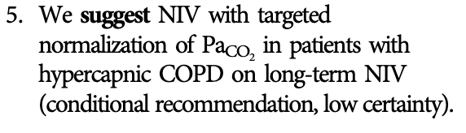
Hypothesis: We Can Identify Them & It Would Help?*
Notes:
Remove this slide.

Slide 9
Evidence Islands
COPD: PaCO2 > 52 mmHg when stable, OSA noncontributory
OHS: PaCO2 > 45 mmHg; No obstruction, AM Co2 up by 7 or PSG
Restrictive (including NMD) ABG 45>, or FVC < 50% or low muscle strength.
Obesity Hypovent
Severe COPD
ALS
Notes:
Hypercapnic respiratory failure is uncommon and can be acute or chronic.
The symptoms are variable, and the diagnosis is frequently missed.
Each case of hypercapnic respiratory failure may have several necessary causes.
Prior research exclusively focused on sufficient causes
Perhaps effect modification?
Patients who develop hypercapnic respiratory failure have many comorbidities that may act as confounders

Slide 10
Recognized Hypercapnia
What portion have applicable evidence-based management?
What portion of patients with hypercapnic respiratory failure qualify for NIV?
Does treatment help the others?
Obesity Hypovent
All Recognized Cases
(Multifactorial Causes,
Relapsing-Recurrent)
Severe COPD
???
ALS
Notes:
Hypercapnic respiratory failure is uncommon and can be acute or chronic.
The symptoms are variable, and the diagnosis is frequently missed.
Each case of hypercapnic respiratory failure may have several necessary causes.
Prior research exclusively focused on sufficient causes
Perhaps effect modification?
Patients who develop hypercapnic respiratory failure have many comorbidities that may act as confounders

Slide 11

All Hypercapnia
What portion of patients are missed?
Are the patients who are missed consequential?
All Cases
Obesity Hypovent
All Recognized Cases
(Multifactorial Causes,
Relapsing-Recurrent)
Severe COPD
???
ALS
???
Notes:
Hypercapnic respiratory failure is uncommon and can be acute or chronic.
The symptoms are variable, and the diagnosis is frequently missed.
Each case of hypercapnic respiratory failure may have several necessary causes.
Prior research exclusively focused on sufficient causes
Perhaps effect modification?
Patients who develop hypercapnic respiratory failure have many comorbidities that may act as confounders

Slide 12
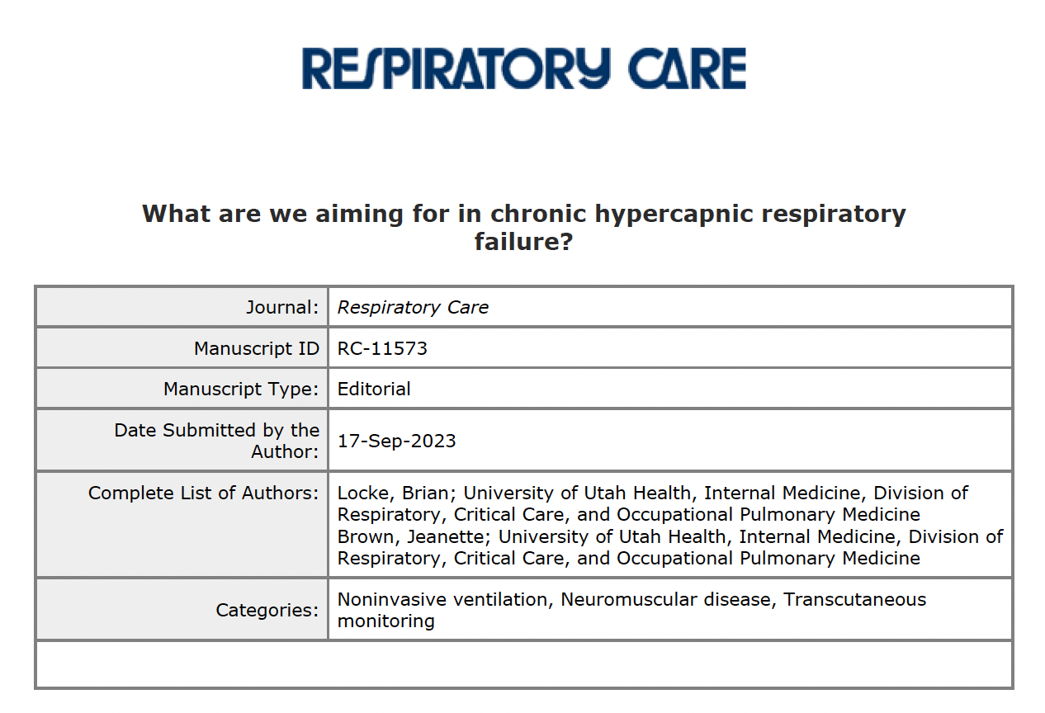

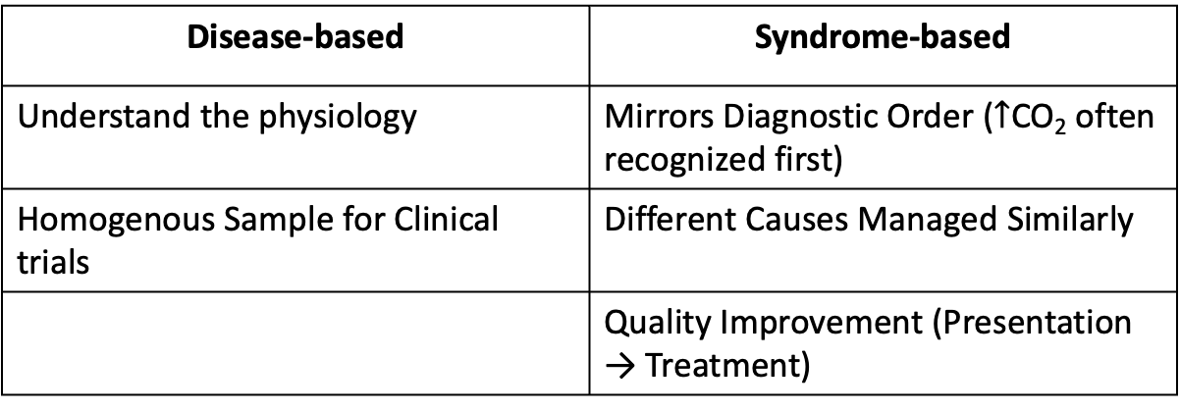
Disease Paradigm Doesn’t Mirror Practice
Disease-based | Syndrome-based
Understand the physiology | Mirrors Diagnostic Order ($↑$CO₂ often recognized first)
Homogenous Sample for Clinical trials | Different Causes Managed Similarly
 | Quality Improvement (Presentation → Treatment)
Notes:
Keep this slide

Slide 13
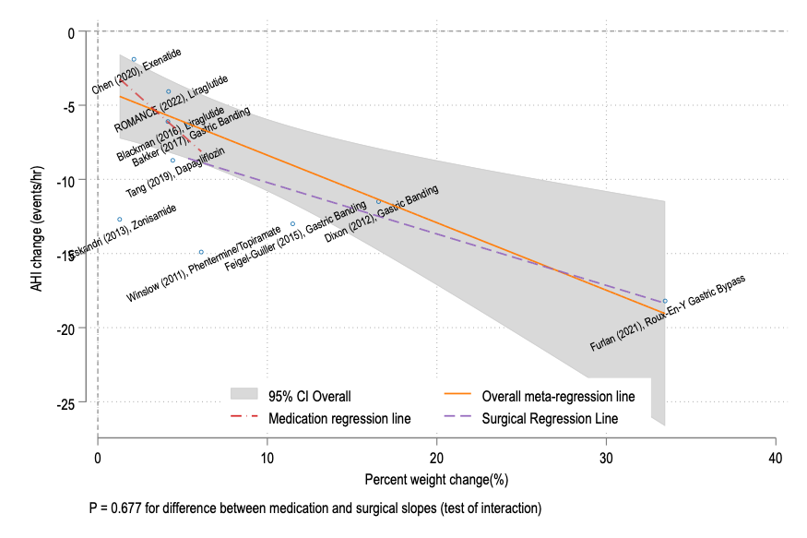
Non-invasive ventilation is not the only option
The Association of Weight Loss from Antiobesity Medications or Bariatric Surgery and Apnea-Hypopnea Index in Obstructive Sleep Apnea: A Systematic Review and Meta-Regression. Brian W. Locke MD; Ainhoa Gomez Lumbreras MD, PhD; Chia Jie Tan PhD; Teerawat Nonthasawadsri PharmD; Sajesh Veettil MSPharm, PhD; Chanthawat Patikorn PharmD; Nathorn Chaiyakaunapruk PharmD, PhD
Obesity and OSA are contributors to many cases
MDCRC 6200 Systematic Review and Meta-analysis
All RCTs: Pharmacologic and Surgical Weight Loss
Expected effect of Tirzepatide: AHI -13.3 events/hr [-8.9 to -17.7]; 44% improvement.
Decrease of 0.45 (95% CI: 0.18-0.73 events/hour) events per hour for each 1% body weight loss
Notes:
Remove this slide

Slide 14
Impact of Doing this Research
Patients with hypercapnic respiratory failure are not well served by our scientific knowledge base
Identified cases are at high risk, but often we don’t know what to do
We unreliably diagnose hypercapnia (even when best management practices known)
Better identification of patients with hypercapnia will allow:
Improved care for patients with understood best management
Improve the rigor of research on multifactorial hypercapnia
Allow for hypercapnic respiratory failure as a study outcome
Benchmark current health system performance at diagnosis and treatment
Notes:
Keep this slide

Slide 15
Approach to the Solution
Hypothesis: Health Record Data contains enough information to helpfully stratify patients with hypercapnic respiratory failure.
Consider:
Example OSA
STOP BANG
Subjective measures: Loud snoring, tired/fatigued/sleepy, observed apneas? Report of HTN Objective measures: BMI, Age, Neck Circumference, Gender
High-risk = increased perioperative complications

Slide 16
Pulse Oximeter vs ???? For CO2.
Hypoxemic (Low O2) Respiratory Failure | Hypercapnic (High CO2) Respiratory Failure
Low arterial blood oxygen tension | High arterial blood carbon dioxide tension
Definitive diagnosis by Arterial Blood Gas | Definitive diagnosis by Arterial Blood Gas
Reliably* Identified by Pulse Oximetry | Limited non-invasive testing
Immediate Life Threat if Severe | Indicates potentially treatable excess risk
Applied widely since 1980s with improved recognition | No systematic Identification

Slide 17
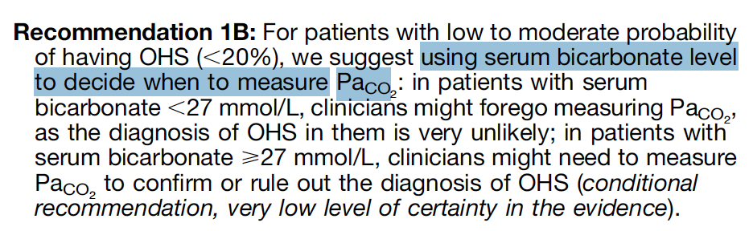
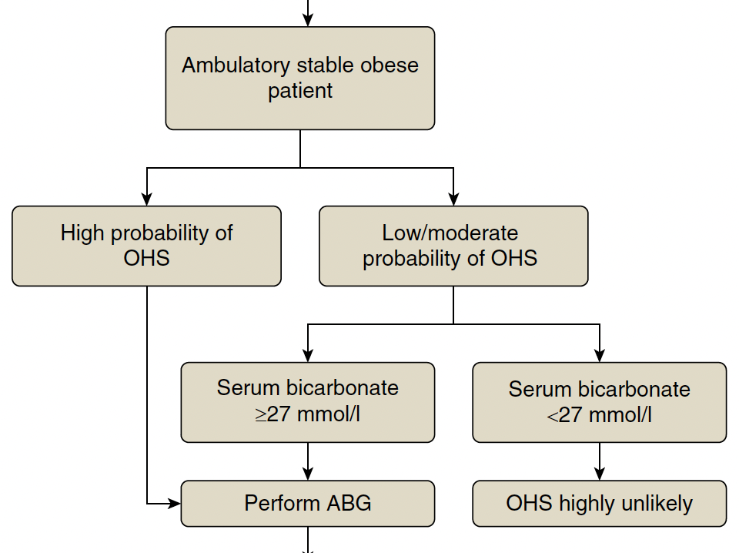
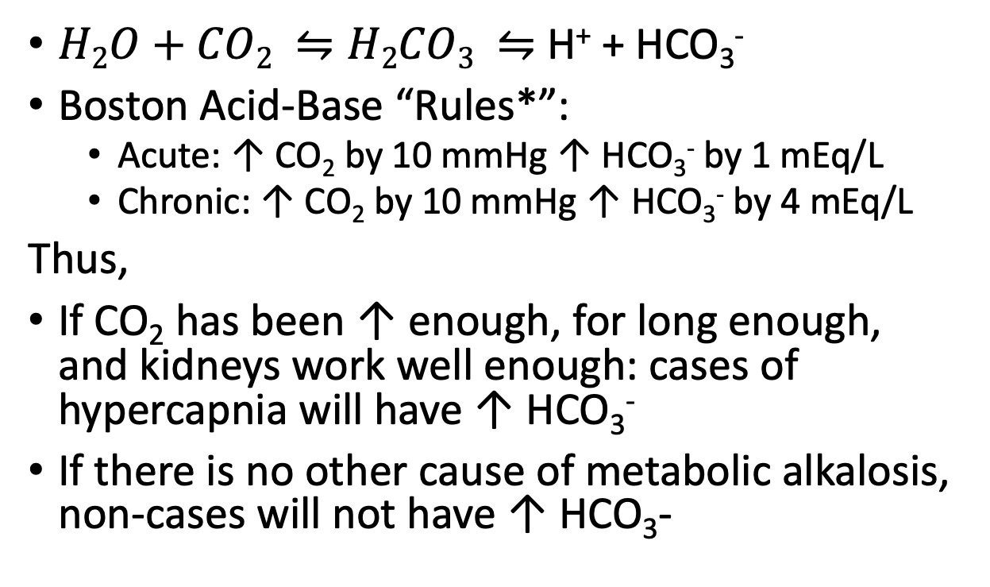
Role of HCO₃⁻ in Diagnosis of Hypercapnia
$H2O+CO2 ⇋H2CO3 ⇋$ H⁺ + HCO₃⁻
Boston Acid-Base “Rules*”:
Acute: ↑ CO₂ by 10 mmHg ↑ HCO₃⁻ by 1 mEq/L
Chronic: ↑ CO₂ by 10 mmHg ↑ HCO₃⁻ by 4 mEq/L
Thus,
If CO₂ has been ↑ enough, for long enough, and kidneys work well enough: cases of hypercapnia will have ↑ HCO₃⁻
If there is no other cause of metabolic alkalosis, non-cases will not have ↑ HCO₃-
Notes:
Henderson Hasselbach is a minimally stochastic predict of what HCO3 will be if PCO2 and pH are known – it will never be wrong
Boston-Acid Base are simplified empirical short cuts that describe behavior – they are not rigorously derived.
Greatly simplify this slide

Slide 18
Does HCO₃⁻ work in other situations?
Target population: patients whom a clinicians should consider hypercapnia
Spectrum bias/effect
Data source: all encounters in TriNetX research network during 2022 who met:
Predisposing condition: COPD, CHF, Obesity…
Diagnostic Testing Sent: VBG, ABG
Related Diagnosis: Other Resp Failure
Related Management: Vent. Support
Inpatient, Outpatient, Emergency Visits
De-identified, patient-level data
Federated Health Record Data
80 US Healthcare Orgs (mostly AMCs)
Allegedly, Reconciled Inter-institution Linkage
NOT able to identify institution
Notes:
Expand this Some

Slide 19
Add slide with what Wayne did

Slide 20
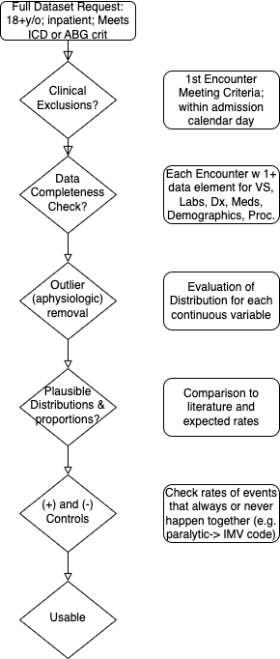
Data Cleaning
Problem for our study
Types of Missing Data:
For a given encounter, the institution must have submitted some data (any data) for each of the data elements requested.
Data validation measures:
Positive controls: if paralytic, expect intubation
Negative controls: <BMI 30 in OHS
True (patho)physiologic state
What the clinician recognizes
What the clinician documents
What information is structured
What data is aggregated in TriNetX
Missing data here is part of what we want to study
Notes:
Perhaps go through and give metrics for how much the original data varied from this: https://www-ncbi-nlm-nih-gov.ezproxy.lib.utah.edu/pmc/articles/PMC5051581/ ←- different categories/metrics of data quality
BMI: 10-100 - BMI is truncated at 50 to avoid identifying notable patients.
RR: 2-75 --- // whats going on with respiratory rates below 4? - do we think these are coding errors or peri-arrest? — seems like they are preferentially in the ventilation procedure code group… perhaps this is an error in how IMV vs spontaneous breaths are coded in the dataset? I think nothing to do here yet.
Temp(F): 30 - 110
Sys BP: 30 - 350
Dia BP: (15 on revamp) 20 - 250
SpO2: 50-100
HR: 15 - 300
Temp: outside 70F - 110F; 20c - 43c
*** If temperature is between 20-43, can be assumed to represent C and converted to Fahrenheit
Example methods discussion from supplement here: https://www.ncbi.nlm.nih.gov/pmc/articles/PMC8404019/)
“Step I. Data preprocessing
To ensure data quality and hypothesis of clustering algorithm was satisfied, the following preprocessing steps were performed:
(1) data cleaning
Data cleaning was performed on vital monitoring and lab result data to filter out erroneous measurement and correct unsuccessful default data conversion. We examined the statistics and distribution plot of selected clinical variables and FiO2 which were used in calculation of PaO2/FiO2 ratio (P/F ratio). Erroneous measurement such as pH < 6 were removed from the dataset. Additional data conversion was performed on entries where the default data conversion is unsuccessful. For example, bicarbonate measure recorded as “>45” was converted to 45 and age recorded as “>89” was converted to 89. For calculation of P/F ratio, if multiple arterial blood gas test (ABG test) results were recorded at same timestamp with different FiO2 settings, P/F ratio were marked as missing value since we were unable to map PaO2 measurements to corresponding FiO2 ventilator settings.
(2) distribution transformation
We examined skewness and distribution plot of selected variables and applied log transformation on variables with long trails (e.g. Blood Urea Nitrogen, Creatinine).
(3) extreme value bounding
Due to clustering algorithms are sensitive to outliers, we bounded all measurements to their 0.02 and 0.98 percentile respectively to eliminate erroneous and extreme values.
(4) normalization
Normalization was performed for each variable. Categorical variables are encoded by 0 and 1.
(5) removing observations with missing variables
Large number of missing values indicate high degree of information loss. To ensure observations in eICU derivation cohort contains adequate information for clustering, all patients with 10 or more missing variables were removed.
(6) missing value imputation
We observed missing values in eICU dataset under different variable extraction window.¹ Due to clustering algorithm did not accept missing value as input, data imputation is required. We assumed: variables are missing at random (MAR). Multiple imputation by chained equations (MICE) was applied to the dataset and all clinical variables were modeled by linear regression.^{2,3} MICE generated 10 independent datasets in the imputation procedure. For visualization, the last imputed dataset was selected to generate plots. For modelling, standard clustering was performed on each of the imputed datasets, and their parameters were pooled to obtain the final model.
(7) correlation analysis
Correlation matrix of selected clinical variables was analyzed.
Step II. Understanding the clustering structure
Data points can group in non-overlapping balls with clear boundaries in between or group in one ball that can be partitioned into multiple subgroup in high dimensional space. To understand the grouping structure of points, we applied a clustering algorithm called ordering points to identify the clustering structure (OPTICS).⁴ OPTICS is a density-based model which can detect clusters in various densities. A reachability plot was produced with OPTICS, which was used to determine if data points are group in non-overlapping balls. If the reachability plot consists multiple segmented curves with points on the tail of one curve significantly higher than most points on another curve, points in the underlying dataset are likely group in non-overlapping balls. If the reachability plot consists one smooth curve, points in the underlying dataset are likely to group in one ball. The reachability plot for both eICU derivation and validation cohort were smooth curves, indicating that points were grouped in one ball and that partition clustering model was preferred.
Step III. Clustering
We used centroid based K-means clustering (K-Means) as the clustering model in this study. To determine the optimal number of cluster k, we examined the Gap statistics and the Gap* statistics. Consensus clustering (CC) is used the cross validation the cluster assignment of K-Means.
To evaluate the clustering result, we considered both theoretical and practical factors including: (1) Goodness of fit (2) Adequate large cluster size (3) Salient difference in clinical characteristics between different phenotypes. Phenotypes were visualized by: (1) t-distributed stochastic neighbor embedding plots (t-SNE)⁵ (2) Line plot of variables normalized by 3 phenotype population mean (3) Rank plot of variables normalized by 2 phenotype population mean.
The optimal number of cluster k is determined by the Gap statistics and the Gap* statistics. Gap statistic compares the total intra-cluster variation for number of cluster k with their expected values under the null hypothesis that distribution has no obvious cluster and is calculated as log of Intra-cluster sum of the pairwise distances.⁶ The difference between Gap statistics and Gap* statistics is that Gap* statistics remove the log function.⁷ In some cases, Gap statistics tend to overestimate the number of clusters but may outperform in the overlapping group cases. In these cases, the optimal number of cluster is determined by the highest Gap statistics value or identifying the first number of cluster k, such that Gap_{n}(k) ≥ Gap_{n}(k + 1) − s_{k+1}. Both Diff value in Gap statistics plot and Gap* statistics plot suggested that optimal number of clusters is 3.
To cross validate the cluster assigned by K-Means, we applied consensus clustering on same data to compare the difference in cluster assignments and phenotype clinical characteristics. Consensus clustering aims to group points into clusters by evaluating degree of confidence or “consensus” of two points are grouped into one cluster under the uncertainty of repeated subsampling.⁸ Pairwise consensus value is defined as “the proportion of time in which two point are grouped in the same cluster” and a high consensus value indicates high goodness of fit. We performed consensus clustering under the ConsensusClusterPlus implementation in R.⁹ We observe a sharp decline in Delta Area plot of CDF from 3 class to 4 class, indicating optimal number of clusters is likely to be 3. Under cluster number=3, cluster consensus for all cluster was above 0.8 and consensus matrix plot suggested that goodness of fit was high.
To further test the stability and robustness of K-Means model, we evaluated the following factors: (1) changes in clinical characteristics of phenotypes between models trained on eICU derivation cohort and eICU validation cohort (2) variance of fitted parameters on multiple imputed datasets by MICE (3) changes in clinical characteristics of each phenotype by altering the clinical variable extraction window from +/-8 hours to +/-12 and +/-24 hours. The clinical characteristics of phenotype generated by K-Means were stable cross all the above tests.
“

Slide 21
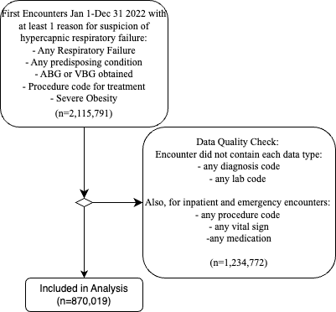
Results:
 | Total | No ABG Obtained | ABG Obtained
 | N=879,019 | N=675,620 | N=203,399
Encounter Characteristics
Ambulatory | 39% (343,699) | 50% (334,457) | 5% (9,242)
Emergency | 20% (175,792) | 22% (146,066) | 15% (29,726)
Inpatient | 41% (359,528) | 29% (195,097) | 81% (164,431)
Critical Care Services Billed | 13% (111,320) | 6% (41,976) | 34% (69,344)
Patient Characteristics
Age (years) | 58 (±18) | 57 (±18) | 61 (±17)
Female | 53% (465,854) | 55% (373,158) | 46% (92,696)
BMI kg/m2 | 34 (±9) | 35 (±9) | 29 (±7)
CHF | 17% (145,615) | 16% (106,492) | 19% (39,123)
CKD | 15% (128,047) | 14% (94,048) | 17% (33,999)
COPD | 16% (144,127) | 16% (106,788) | 18% (37,339)
Neuromuscular Disease | 4% (35,539) | 4% (27,725) | 4% (7,814)
OSA | 21% (188,757) | 24% (160,082) | 14% (28,675)
Diuretics (outpatient) | 38% (334,400) | 38% (256,188) | 38% (78,212)
Opiate (outpatient) | 59% (518,493) | 57% (387,725) | 64% (130,768)
Serum Bicarbonate (mEq/L) | 24.6 (±4.7) | 25.0 (±4.1) | 23.6 (±5.7)
Outcomes
Non-invasive Ventilation? | 4% (32,542) | 2% (15,352) | 8% (17,190)
Invasive Mechanical Ventilation | 6% (52,533) | 1% (10,054) | 21% (42,479)
CO2 >= 45 mmHg? | 32% (64,544) |  | 32% (64,544)

Slide 22
Statistical Analyses:
Receiver Operating Characteristic (ROC) Curve Analysis | ROC-Generalized Linear Modeling | Interval Likelihood Ratios (iLR)
How well does HCO₃⁻ separate patients with ↑CO₂ from those without (discrimination)? | What characteristics independently associate with better or worse discrimination? | How much does a particular HCO₃⁻ value change the likelihood of ↑CO₂ being present?
(Exposure) HCO₃⁻ and (Outcome) ABG obtained on 1st day of encounter.

Slide 23
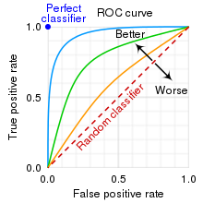
Results:

Slide 24
Results:

Slide 25
Results:

Slide 26
Additional hypothesis: Potassium levels will improve accuracy.
Rationale:
False positives are caused by metabolic alkaloses
Most metabolic alkaloses cause hypokalemia (diuretics, vomiting, hypovol.)
Therefore, high bicarbonate with normal/high potassium is more likely a true positive

Slide 27
Results:
Notes:
↓HCO₃⁻ & ↓K⁺ = Unlikely hypercapnic
↑HCO₃⁻ & ↑K⁺ = Likely hypercapnic
↓HCO₃⁻ & ↑K⁺, ↑HCO₃⁻ & ↓K⁺ = less strong evidence for or against

Slide 28
Conclusions
Serum bicarbonate is potentially diagnostically useful in a variety of previously unvalidated situations
Some factors correlate with better performance (e.g. Loop diuretic, COPD, CHF, female sex, older age) and others with worse (ER, CKD, Opiate use)
Loop diuretic performance contradicts prior hypothesis: while they increase false positives, they decrease false negatives more.
New Finding: Potassium levels and bicarbonate together provide stronger evidence for or against hypercapnia being present.

Slide 29
Limitations:
Partial verification: not everyone gets an arterial blood gas to verify if they have hypercapnia or not.
Current Finding applies to type of patients who get ABGs
Probability of obtaining an ABG is variable and idiosyncratic
Inverse probability of blood-gas weighting? Missing data is tricky
‘Acute’, transient hypercapnia will be under-identified.
Will miss if inadequate time for kidneys to retain HCO₃⁻
Calendar-day time matching
Is this a bad thing?
Is the data quality sufficient?
Restricted analyses to single-encounter data (cross-sectional)

Slide 30
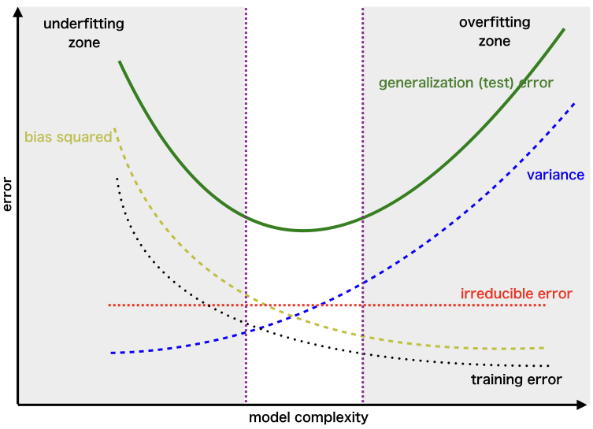
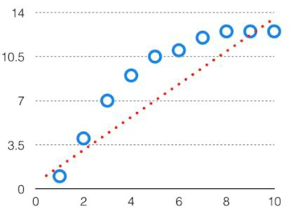
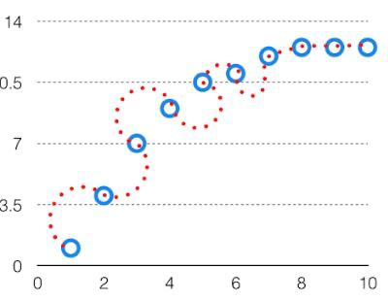
Future: More Predictors = Better?
Traditional clinical test evaluation → bioinformatics
(priority from easy to understand → works better)
Approach: Cross-validation
Bias | Variance
Miss the signal (underfitting) | Fitting the noise(overfitting)
Too far in either direction = worse performance with new data.
Notes:
https://www.geeksforgeeks.org/ml-bias-variance-trade-off/amp/
Dichotomization = easy to understand, but not very good use of information

Slide 31
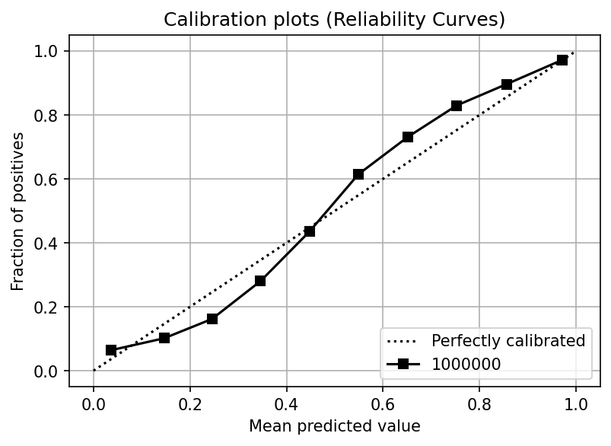
Approach:
Same Dataset
Take structured data elements that are immediately available in HER
Age, Sex, Serum HCO₃⁻ , Serum K⁺, Serum Creatinine, BMI, Hgb, Venous BG
Modeling approach: Logistic regression with restricted cubic splines
Random-forest decision trees: more flexible, less interpretable.
Output: Predicted (log-odds) of Hypercapnia

Slide 32
Preliminary Results
TBD

Slide 33
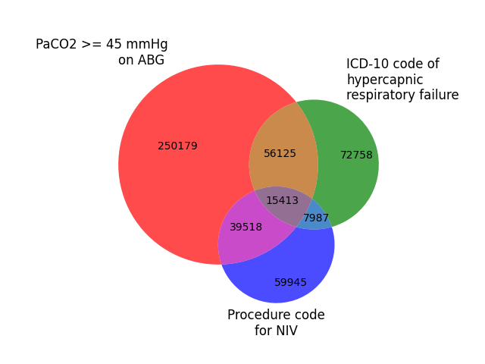
How can this be put to clinical use?
Computable Phenotype: algorithms that use more information to label whether a patient has a disease.
How you decide who ”counts” as having hypercapnic respiratory failure influences the types of patients included..
Inaccurate disease status classification is a problem for existing EHR-based research
Use for: Exposure, Covariable Adjustment, Outcomes

Slide 34

K23: 5-yr
Aim 2: Prospective Validation of PPV
Refinement and Validation of a method for constructing cohorts of patients with hypercapnia – robust to variable diagnostic performance.
Aim 3: Evaluation of Prognostic Significance
Aim 1: Add Unstructured Data
Validation & Tuning
Probabilistic Modeling Likelihood of Hypercapnia
Notes:
Aim our best to construct this cohort:
As a byproduct, we will also discover information about:
- proof of principle whether there are importantly missed patient out there
- insight into the likely impact of of those misses

Slide 35
Aim 1: Incorporate Unstructured Data
Prior efforts use data points you can’t get from structured fields
(=can only take specific values)
Natural Language Processing, Large Language Models
BioBERT: LLM (like ChatGPT) pre-trained on medical text (PubMed/PMC)
Train to recognize hypercapnia predictors using MIMIC4: 65,000 ICU admissions MGH/BWH
Nursing triage assessments, Chest XR
Apply with model to retrospective data from the University of Utah.
Reference standard: patients who had arterial blood gasses obtained.
Adjust model weights
Generate measures of model performance (discrimination and calibration) to inform other aims
OSA | Pulmonary Embolism
STOP BANG | WELLS Score
Subjective measures: Loud snoring, tired/fatigued/sleepy, observed apneas? Report of HTN Objective measures: BMI, Age, Neck Circumference, Gender | Signs/Symptoms of DVT PE is most likely HR over 100 Immobilized/Surgery w/n 4 weeks Prior PE, Hemoptysis Malignancy
High-risk = increased perioperative complications | 0-1 points = <1.2% prevalence 2-3 points = 16.2% prevalence 4+ points = 37.5% prevalence
1990: Run a big enough prospective study and ask everyone
2023: Get ChatGPT to do it from what people document
Notes:
An important element not discussed here is the local fine-tuning that must occur.

Slide 36
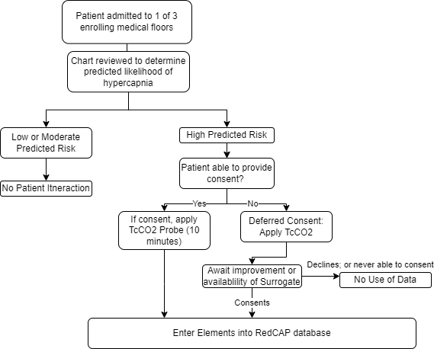
Aim 2: Prospectively Validate: UUH Inpatients
Deferred consent (CO₂ Narcosis)
Verify Positive Predictive Value (precision) in predicted high-risk patients with Transcutaneous CO2
Smaller sample stratified sampling of the whole population.
Prioritizes proof of concept, rather than delineate scope of the problem (initially)
Sample Size Calculation: stata diagsampsi
Rate of presentation to hospital: *** (TriNetX)
% Predicted High Risk: (10%)
% of eligible enrolled
25% ‘prevalence’ (Nowbar); model AUC; Se/Sp TcCO2 for true reference standard 85%/85%
Notes:
How will this fail?
Aim 1 results will influence needed sample size
Can I access EHR data fast enough?
Hawthorne effect? Due to hypoxemia (elevation), do they get identified earlier?

Slide 37
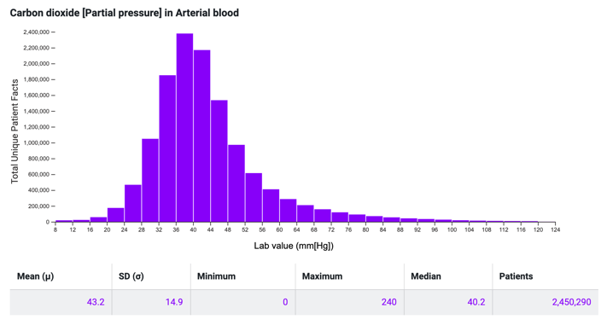
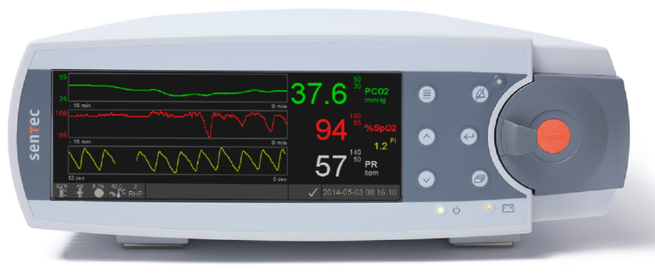

Prior work:
Tool | Health Record-Based Modeling | Transcutaneous CO2
Purpose | Refine Estimation of Pre-test Odds of Hypercapnia | Allow non-invasive CO2 assessment (patients unlikely to consent for research ABGs)
Limitation | Approach only externally validated in outpatient OHS assessment | Prior 95% agreement +/- 6 mmHg insufficient for unstratified clinical use
…
49: Correct 93%, Wrong 7%: weight: 1.98%
48: Correct 88%, Wrong 12%: weight: 2.39%
47: Correct 80%, Wrong 20%: weight: 2.47%
46: Correct 69%, Wrong 31%: weight: 2.92%
45: Correct 57%, Wrong 43%: weight: 3.11%
SENSITIVITY
SPECIFICITY
44: Correct 57%, Wrong 43% 3.56%
43: Correct 69%, Wrong 31% weight 3.73
42: Correct 80%, Wrong 20% weight 4.16%
41: Correct 88%, Wrong 12% weight 4.25%
40: Correct 93%, Wrong 7% weight 4.58%
….
Expected test characteristics:
sensitivity = 89%
specificity = 92%
if
agreement ~6 mmHg
same distribution of CO2

Slide 38
Aim 3: Estimate the potential impact
Prior efforts use data points you can’t get from structured fields
(=can only take specific values)
Overdiagnosis: people who meet the definition of disease, but do not benefit from it
PaCO2 is an imperfect reference standard for what we care about: future harm
Possible – though not likely – clinicians already identify the important cases
Need a ‘loyalty cohort’: patients whose rehospitalizations would be captured.
Veterans Affairs – or artificially constructed one from another data source.
Hypothesis: Patients predicted to have had hypercapnia that was not recognized have a similar or excess risk of subsequent readmission as those identified (by blood gas and/or ICD code)
Notes:
e.g. we don’t just want to focus on identifying more patients who would have a blood gas CO2 over 45 mmHg if it were checked… we want to identify the patients who have and are going to continue to have clinically important respiratory failure and, ideally, those who will benefit from known therapies.
Retrospective cohort of patients predicted but not recognized to have hypercapnia
Longitudinal, high % follow-up within-system (VA)
Number of ”predicted likely” visits before definitive recognition
Hazard of ED visit, admission, mortality (comparison: ABG confirmed, ICD confirmed, treated)
Prediction: patients likely to have hypercapnia incur similar to increased risk of those confirmed.
supports, but does not demonstrate, that recognition may be beneficial
Threats to validity:
Is it the hypercapnia risk, per-se? (negative controls)
Risk might be ameliorated by treatment
Risk among patients with hypercapnia is not binary [ie risk PaCO2=90 >>> 50]
Other relevant data: sources of variation in probability of obtaining ABG or VBG, referral to sleep

Slide 39
OVERALL: Patients with Consequentially Missed Hypercapnia can be Identified Using Health Record Elements | OVERALL: There is a significant burden of unrecognized hypercapnia among hospitalized patients. 3 aims
 | Aim 1: Model Refinement and Local Optimization | Aim 2: Prospective Validation | Aim 3: Assess Potential Impact
Hypothesis | Fine-tuning and refining previously derived model will improve local performance | Patients with hypercapnia that are not recognized are common can be identified using health record elements with high positive-predictive value. | Inpatients who were predicted, but not confirmed, to have hypercapnic respiratory failure are at high risk of adverse outcomes.
Rationale | The model should be optimized for local performance | Must be verified that model identifies unrecognized hypercapnia | Need to confirm that the identified patients face elevated risk (ABG PaCO2 is an imperfect reference standard).
Approach | Optimizing model performance +/- use of NLP tools) applied to U of U data | Non-invasively sample (with TcCO2) patients predicted to have hypercapnia that teams have not recognized | Among patients with an admission for hypercapnia that is identified, how many had preceding admissions likely to have hypercapnia?
Design | Retrospective, U of U | Prospective, U of U | Retrospective, VA
Payoff: This work will evaluate the potential for improved recognition of hypercapnia to help a particularly high-risk, enlarging, and understudied group of patients. Career Development: Prospective validations of bioinformatic tools require a unique skillset
Notes:
[ ] update this

Slide 40
Summary
Related Questions
Methods of handling of partial verification
Regression-based vs Random Forest (or other ML)
Clinical and modeling Incorporation of Venous BG
Socio-technical barriers to diagnosis
Longitudinal Cohort Creation
Is UT atypical? (elevation)
Sources of provider/unit/institution variation?
Brian.Locke@hsc.utah.edu
Considering hypercapnic respiratory failure as a syndrome offers insight into its attributable health burden
Current diagnosis is haphazard and suboptimal
This introduces problems for patient care and reliable research.
Better use of health record data can help address both problems.
Preliminary work has led to new clinical features, but more sophisiticated modeling is needed for impact.

